Slide 1
Earthquake Resistant Buildings in Developing Countries.

Slide 2
Introduction.
Developing countries are featured with a large number of unregulated masonry buildings.
Majority of these structures are located in areas of high intensity of seismic activities.
Traditional buildings are susceptible to partial or total damage and collapse during earthquakes.
Many common apartments and other typical methods of constructions lack fundamental resistances to earthquakes.

Slide 3
The Problem.
Earthquakes have remained disastrous especially in developing countries.
Engineers in developing countries lack the necessary knowledge, facilities and innovativeness to structure buildings which can inevitably act against seismic forces.
Lower-middle-class engineers prefer unreinforced masonry construction technology because of the ease in the design and construction process as well as the reduced cost (Choudhury et al., 2015).
It is imperative that developing countries should take initiatives to solve this problem and ensure safety.

Slide 4
The causes of the problem.
Buildings collapse due to the following reasons.
The foundations are too weak.
If the foundations are not strong enough to pull the structures along with it, the building will definitely collapse.
The building materials are not strong enough.
Building’s ability to resist earthquake relies on the strength of the materials it is made of.
The soil fails.
Seismic activities move the ground in irregular directions and they eliminate soil’s ability to support the weight.
Buildings on soft soils and in steeply sloped sites in seismic zones are in great risks when an earthquake hits.

Slide 5
The effects of the problem.
Human deaths.
Earthquakes are random and unpredictable forces, they often find people in these apartments unprepared.
They claim lives when the buildings collapse.
Mass injuries.
The survivors have a high chance of living a miserable life because some are hit by the building materials to the extent of breaking their body parts.
Economic loss.
Earthquakes bring about immeasurable costs to the community and the nation at large.

Slide 6
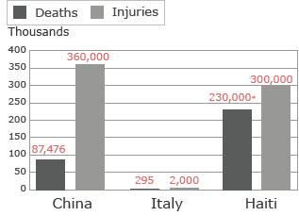
Graphical representation human cost of earthquakes in Haiti, China and Italy.
Notes:
The shocking earthquakes that hit China in 2008, Italy in 2009 and Haiti in 2014 all measured above 6.0, and all claimed lives of many people. However, the impacts of these seismic activities were more challenging in developing countries than the case with developed countries.

Slide 7
The solutions.
Reinforcing walls.
The approach is effective in preventing failure as well as collapse when buildings experience shakes.
It is done by use of reinforced concrete jackets on both faces of wall and application of FRP structural repointing for the strengthening of masonry walls.
Reinforced concrete jackets on both faces of walls.
It is more applicable for stone masonry walls.
The plaster is removed from the masonry walls, the mortar joints are cleaning, and cracks on the walls are filled.
Anchor ties are inserted in the pre-drilled holes.

Slide 8
Important parameters of earthquake designs.
Engineers should ensure acute consideration of important parameters of the seismic design.
Identical features of construction materials should be keenly evaluated.
Engineers should focus on load delinquency features of building components.
The basic aspects of designing earthquake-resistant structures are ductility, deformability, and damageability or robustness (Subramani & Vasanthi, 2016).

Slide 9
Ductility.
It is the ratio of displacement of a structure just before the ultimate collapse.(Arya et a., 2014).
This will help to solve the problem by ensuring that all construction materials are sufficiently ductile at the point of tensile stress.
Damageability or robustness.
Damageability is the capability of a structure to undergo and sustain substantial damage without collapsing (Subramani & Vasanthi, 2016).
Damageability depicts signs of collapse thus creating chances for repair.

Slide 10
Use of technical innovations.
The engineers should apply the trending technical innovations from other nations to solve the problem (Miao & Popp, 2014). These include:
The levitating foundation.
It involves floating a building literally above its foundation fitted with lead-rubber bearings.
The system is fitted with sensors which detect seismic activities and pass a signal to the air compressors.
The cushion of air lifts the building to separate the building from seismic forces.
The building settles back after the earthquake ends.

Slide 11
Seismic invisibility cloak.
This engineering technology is based on borderline science fiction.
It entails shielding the building with seismic invisibility cloak which would effectively alter the transmission of seismic waves in the structure.

Slide 12
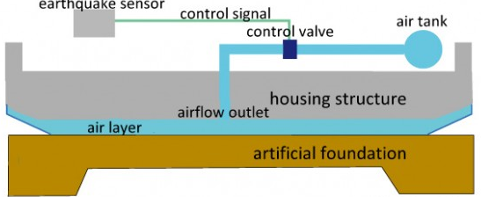
The levitating foundation technology in earthquakes.
Notes:
This is one of the best technical innovations with the capability to solve the risks of the earthquake. As argued, the technique depends on isolating substructures of buildings from the superstructure. The version involves floating a building literally above its foundation fitted with lead-rubber bearings.

Slide 13
Recommendations.
Walls should be fitted with outside pillars.
Earthquake-prone areas should be converted into farms or parks to reduce the risk (El-Masri & Tipple, 2002).
Adoption of code provisions for design and reinforcing of buildings in developing countries.
Simple and inexpensive principles of good building construction practice (Arya et a., 2014).

Slide 14
Conclusion.
Past experiences have demonstrated that earthquakes have devastating consequences.
Earthquakes require acute mitigation.
Engineers play a core role in addressing this issue by making efforts to establish earthquake-resistant buildings in the context of developing nations.
The affordable solutions are:
Reinforcing walls.
Consideration of the imperative features of the seismic design.
Integration of technological innovations in engineering.

Slide 15
References.
Arya, A. S., Boen, T., & Ishiyama, Y. (2014). Guidelines for earthquake resistant non-engineered construction. UNESCO.
Choudhury, T., Milani, G., & Kaushik, H. B. (2015). Comprehensive numerical approaches for the design and safety assessment of masonry buildings retrofitted with steel bands in developing countries: The case of India. Construction and Building Materials, 85, 227-246.
El-Masri, S., & Tipple, G. (2002). Natural disaster, mitigation and sustainability: the case of developing countries. International planning studies, 7(2), 157-175.
Miao, Q., & Popp, D. (2014). Necessity as the mother of invention: Innovative responses to natural disasters. Journal of Environmental Economics and Management, 68(2), 280-295.
Subramani, T., & Vasanthi, R. (2016). Earth Quake Resistant Building Using SAP. International Journal of Application or Innovation in Engineering & Management (IJAIEM), 5(5), 173-181.

